Slide 1
Western States Forecasting Update
July 23, 2019

Slide 2
Forecasting Goals
Tracking 5 years of Boilermaker demand
Anticipating peak demand needs to better plan supply of qualified “A List” workers
Communicating information with Contractors and Owners to assist in peak demand scheduling
Notes:
goals

Slide 3
New Tool: WSForecast.com
Secure and confidential online site for storing upcoming job data
Job information can be easily entered and tracked anywhere
Allows data informed decision making based on automatic manpower report generation

Slide 4
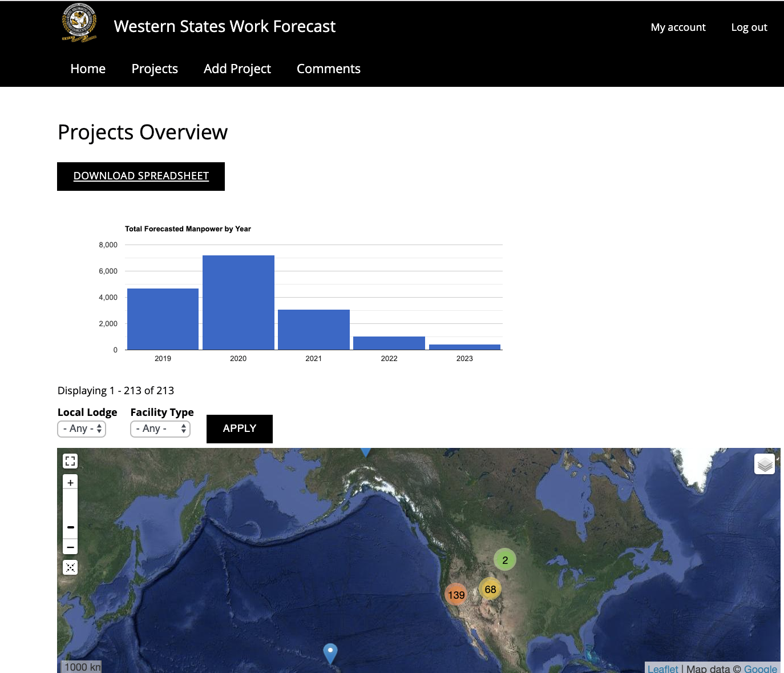

Slide 5
Information
Start Date
Address
Total Boilermakers
Contractor Name
Facility Name
Owner

Slide 6
Moving Forward
Gathering information from different sources to create a complete Western States wide manpower demand tracker
Better plan our upcoming work, see where we are not working, pass upcoming jobs to members
Rollout of WSForecast.com to our business managers
Notes:
Everyone here should track their own work already. This can be the wishlist you keep even if pie in the sky type jobs. With higher demand for boilermakers particularly in Washington and California in the upcoming years it is going to be crucial to have fore knowledge of what is coming up in order to aid our recruitment efforts to man jobs. Jobs with lower probability of occurring can be tracked and if additional resources are needed via lobbying efforts this provides an area to designate that as well. With consist information from WSF and MBDS we can forecast our boilermaker load based on outage and turnaround schedule.

Slide 7
Feeding Our Growth
Continual push to communicate and receive job projections to better plan work
Updating of WSForecast for Local Lodge access to be continually informed of upcoming Boilermaker demand
Using newly aggregated data to feed recruitment and organizing drives to increase our manpower
Notes:
WsForecast is replacing other forms of job forecasting. We have talked about the benefits of forecasting our work for over a year and WSF is the final culmination of how this will be done. It has always been the business managers responsibility to track upcoming jobs, rather than keeping this information in different places we want to always make it available online.

Slide 8
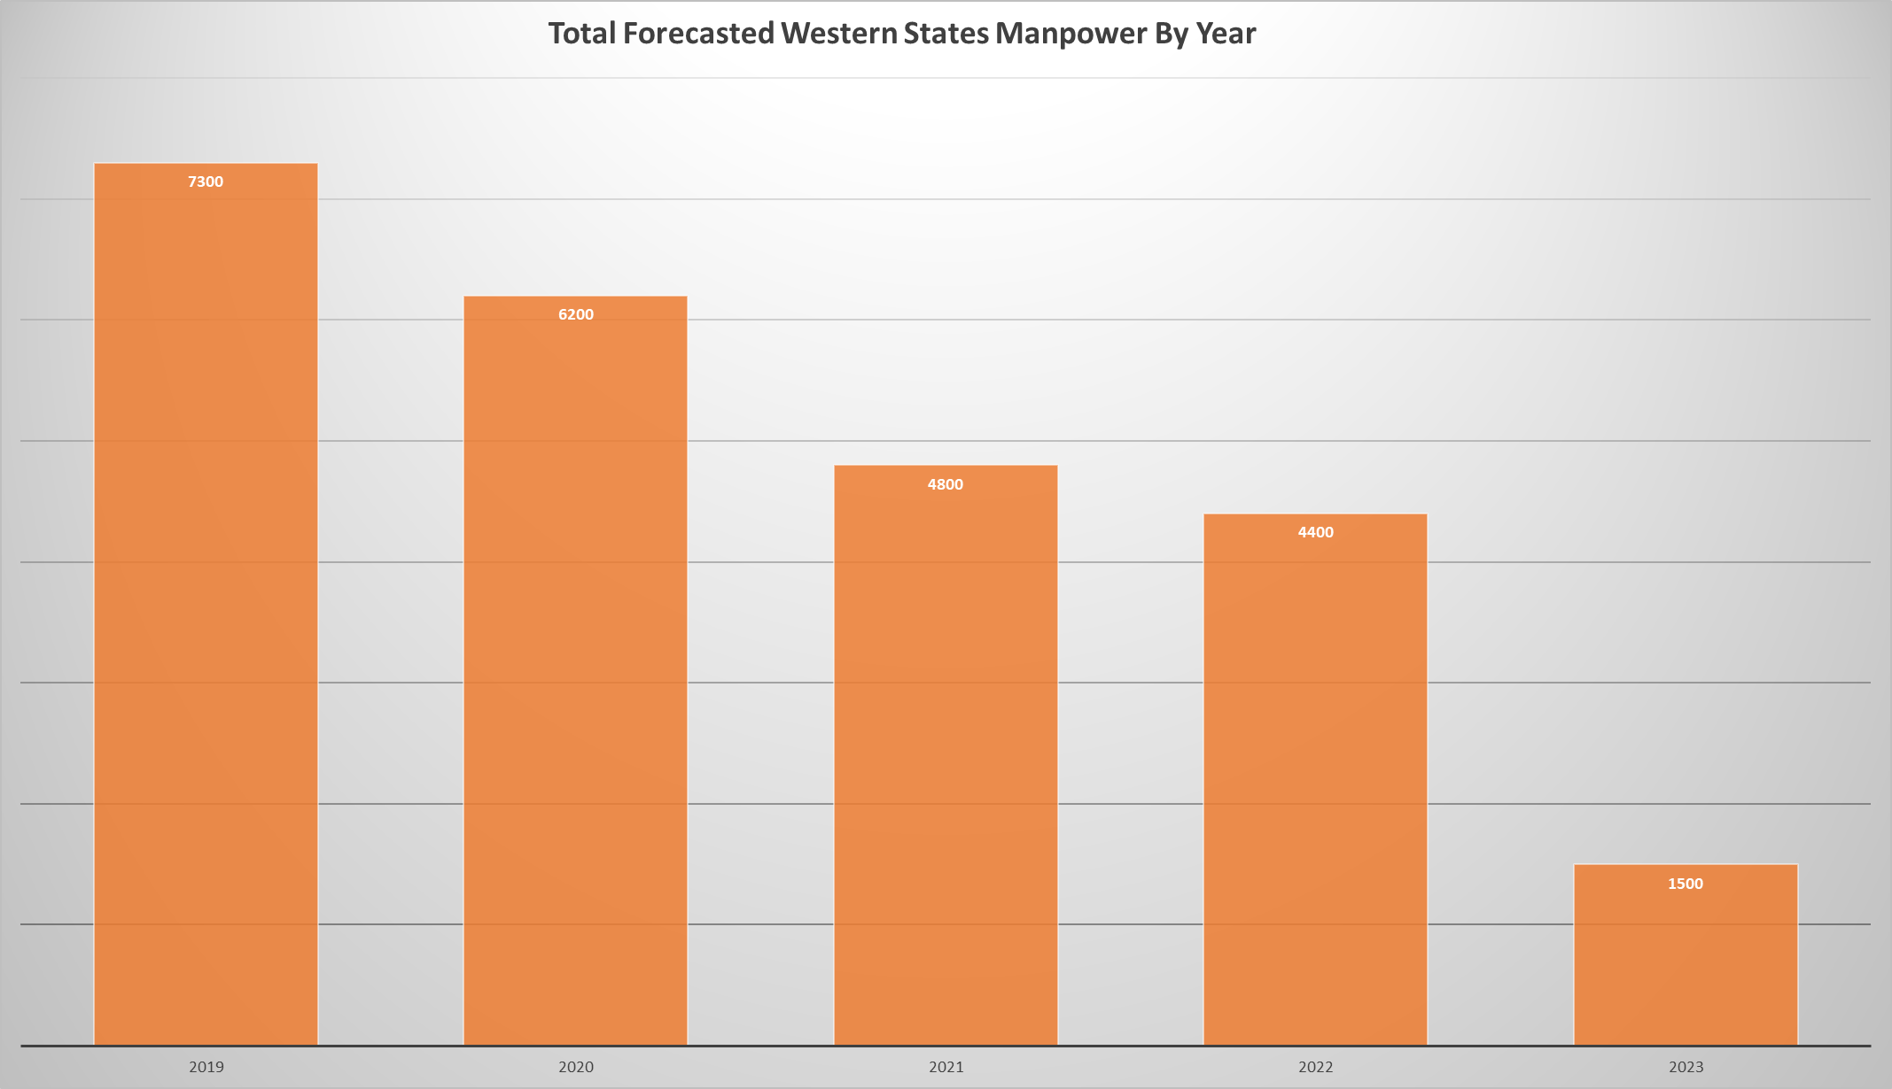

Slide 9
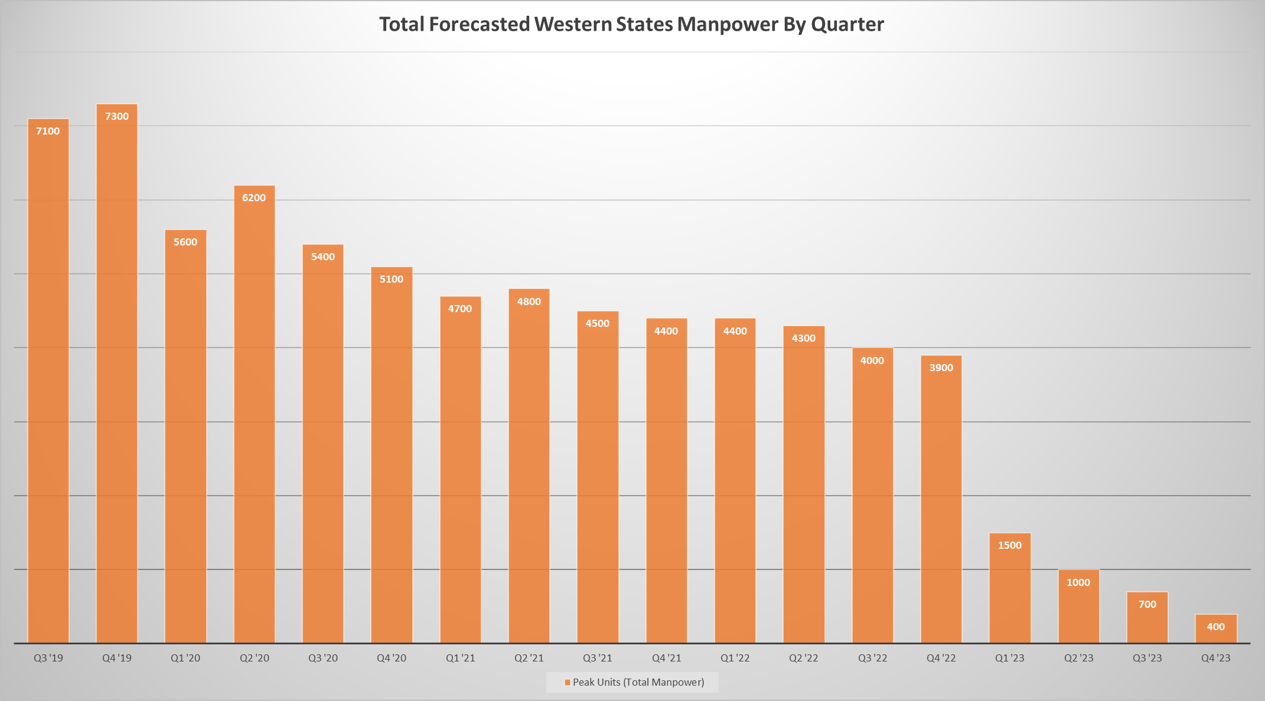

Slide 10

Manpower Shortages
July 23, 2019

Slide 11
Recruiting Efforts
We are recruiting to:
Staff the work that is already scheduled.
Build our resources to make certain that we can supply additional qualified craftsmen at “peak” outage season when necessary.
To encourage Contractors to bid additional work with the knowledge that we can staff the job.

Slide 12
Recruiting Efforts
We have began efforts to:
Recruit and advertise in traditionally “non-Union” magazines.
Our competition already has been for some time.
Track outage work at facilities that may use craftsmen similar to our needs for recruiting efforts.
Reach out to Owners and market ourselves as a trade.

Slide 13
Recruiting Sucesses
Total Member Count By Local Lodge
Local Lodge | Member Count
4 | 270
11 | 183
92 | 1146
101 | 147
242 | 380
502 | 207
549 | 710
627 | 433
 | 3476

Slide 14
Recruiting Successes

Slide 16
Recruiting Database
Recruits seeking Boilermaker employment need an avenue to come into our industry.
A skilled craftsman needs to be responded to and evaluated quickly.
We have built a recruiting database to assist in this matter.

Slide 17

Recruiting Database-Incoming
After the telephone interviewing is completed, all applicants will be separated by skill-level and experience.
Experienced Journeymen and Welders will:
Be sent to Local Lodge or Training Center for Evaluation.
Safety trained.
Made ready for referral & employment.

Slide 18
Recruiting Database-Non-Experienced
Non-experienced applicants will be sent to the Local/Area Apprenticeship or Helper Program.
Applicants with limited experience and welding ability will be taken on a case-by-case basis and brought up to Boilermaker standards through Local Lodge assistance or Bootcamp training.

Slide 19

Conclusion
This is just a small part of our current efforts and we are seeking to expand as time, assistance, and financial resources are made available.

